Slide 1
Systems Thinking and Software Engineering Ethics
CS 4320 / 7320 Software Engineering
Professor Sean P. Goggins

Slide 2
Schedule
1. Today: Systems Thinking and Ethics
2. Tuesday: Introduction to the next module: Design
3. HCI Design

Slide 3
Systems Theory
Knowledge
Analysis
Decomposition
Break apart
Understanding
Synthesis
Finding Connections
Putting together
Software engineering is the understanding of unintended consequences.
Deterministic v Non-Deterministic Systems

Slide 4
Systems Thinking Benefits: Less Reaction, More Strategy

Slide 5
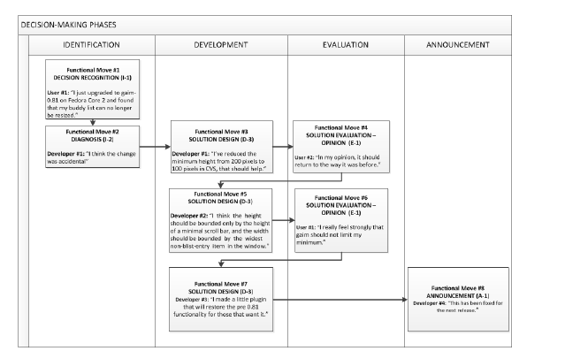
Systems Theory: Software Decision Making Phases (Eseryel, Wie & Crowston, 2020)
I – Idea
D – Development
E – Evaluation
A – Announcement
Yeliz Eseryel, U., Wie, K., & Crowston, K. (2020). Decision-making Processes in Community-based Free/Libre Open Source Software-development Teams with Internal Governance: An Extension to Decision-making Theory. Communications of the Association for Information Systems, 484–510. https://doi.org/10.17705/1CAIS.04620

Slide 6
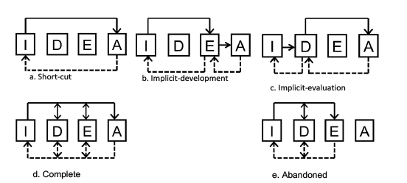
Systems Theory: Software Decision Making Phases (Eseryel, Wie & Crowston, 2020)
I – Idea
D – Development
E – Evaluation
A – Announcement
Five Decision Making Patterns Among Open Source Teams
Yeliz Eseryel, U., Wie, K., & Crowston, K. (2020). Decision-making Processes in Community-based Free/Libre Open Source Software-development Teams with Internal Governance: An Extension to Decision-making Theory. Communications of the Association for Information Systems, 484–510. https://doi.org/10.17705/1CAIS.04620

Slide 7
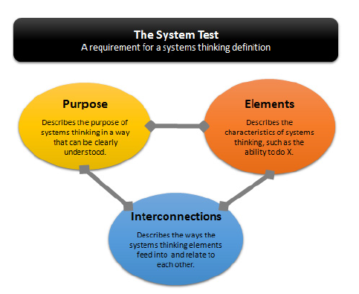
Recognizing a System (Arnold and Wade, 2015)
The System Test
Arnold, R. D., & Wade, J. P. (2015). A Definition of Systems Thinking: A Systems Approach. Procedia Computer Science, 44, 669–678. https://doi.org/10.1016/j.procs.2015.03.050

Slide 8
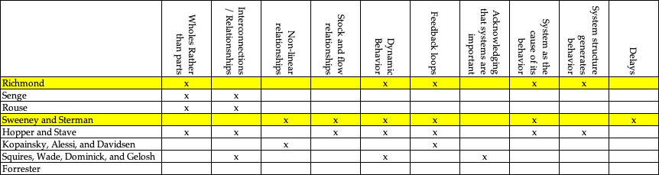
Recognizing a System (Arnold and Wade, 2015)
Comparing Definitions
Arnold, R. D., & Wade, J. P. (2015). A Definition of Systems Thinking: A Systems Approach. Procedia Computer Science, 44, 669–678. https://doi.org/10.1016/j.procs.2015.03.050
Notes:
Barry Richmond’s definition
Barry Richmond, the originator of the systems thinking term, defines systems thinking as the art and science of
making reliable inferences about behavior by developing an increasingly deep understanding of underlying structure10
(Richmond, 1994). He emphasizes that people embracing Systems Thinking position themselves such that they can
see both the forest and the trees; one eye on each10 (Richmond, 1994).
Peter Senge’s definition
Peter Senge, another leader in the field, defines systems thinking as a discipline for seeing wholes and a framework
for seeing interrelationships rather than things, for seeing patterns of change rather than static snapshots11 (Senge,
1990). Senge also asserts that people who succeed in handling complexity are working in an intuitive domain we
don't even consider in our educational theories, underscoring an intuitive property of systems thinking1 (Benson,
Borysenko, Comfort, Dossey, & Siegel, 1985).
Senge’s definition, although interesting, is also vague. The definition does describe several highly critical elements
of systems thinking, but it does not provide a purpose for systems thinking. It could be argued that this lack of purpose
makes the definition difficult to understand. Also, the interconnections between elements are not specified or
recognized. Therefore it does not pass the System Test. However, the way that Senge defines systems thinking by
describing it as a discipline and a framework seems to evoke a certain understanding of its deeper meaning, hinting at
its nature as a system.
Sweeney and Sterman’s definition
Linda Sweeney and John Sterman, authors and researchers in the field of systems thinking, found that that much
of the art of systems thinking involves the ability to represent and assess dynamic complexity (e.g., behavior that
arises from the interaction of a system’s agents over time), both textually and graphically15 (Sweeney & Sterman,
2000). They list specific systems thinking skills as including the ability to:
1. Understand how the behavior of a system arises from the interaction of its agents over time (i.e., dynamic
complexity);
2. Discover and represent feedback processes (both positive and negative) hypothesized to underlie observed
patterns of system behavior;
3. Identify stock and flow relationships;
4. Recognize delays and understand their impact;
5. Identify nonlinearities;
6. Recognize and challenge the boundaries of mental (and formal) models.
Sweeney and Sterman attempt to define systems thinking in terms of a purpose, to represent and assess dynamic
complexity, but they don’t explain what the purpose of assessing dynamic complexity is (to aid in solving systemic
problems). They then break this definition down into parts. It seems that Sweeney and Sterman’s high level definition
can immediately be reduced to this simpler statement: The art of systems thinking involves the ability to represent and
assess dynamic complexity. This idea is then followed by their six specific systems thinking skills.
Overall, this definition is extremely useful, as it lists actual skills agreed upon by many advocates of systems
thinking15 (Sweeney & Sterman, 2000). However, this definition fails the System Test because it does not clearly
define a purpose or goal that relates to everyday life. Also, interconnections between elements are not addressed. The
definition fails to capture the overall nature of systems thinking - the parts interacting to form a whole system.
Hopper and Stave’s definition
Megan Hopper and Krystyna Stave incorporated Sweeney and Sterman’s work, and the work of many others, into
their own study of systems thinking. Reinforcing the need for a widely accepted definition, they assert that the term
systems thinking is used in a variety of sometimes conflicting ways13 (Stave & Hopper, 2007). For example, some
system dynamicists see it as the foundation of system dynamics as well as a number of other systems analysis
approaches; others see systems thinking as a subset of system dynamics13 (Stave & Hopper, 2007). Hopper and Stave performed an extensive review of systems dynamics literature, drawing up the following list of Systems Thinking
Characteristics based on their findings13 (Stave & Hopper, 2007):
1. Recognizing Interconnections
2. Identifying Feedback
3. Understanding Dynamic Behavior
4. Differentiating types of flows and variables
5. Using Conceptual Models
6. Creating Simulation Models
7. Testing Policies
Hopper and Stave draw upon Richmond, Senge, Sweeney and Sterman in their definition, along with many others.
However, their definition does not contain interconnections or a statement of purpose for systems thinking, and thus
fails the System Test. Their definition is simply a set of characteristics, and not a system.
Kopainsky, Alessi, and Davidsen’s definition
Building on Hopper and Stave’s work, Birgit Kopainsky, Stephen M. Alessi, and Pål I. Davidsen, state that the
definition of systems thinking should include appreciation for long term planning, feedback loops, non-linear
relationships between variables, and collaborative planning across areas of an organization4 (Kopainsky, Alessi, &
Davidsen, 2011).
This definition adds several new characteristics to Hopper and Stave’s. However, it suffers from the same problem–
it does not define systems thinking as a system, only a set of characteristics. The elements are defined, but not the
purpose or interconnections, thus failing the System Test.
Squires, Wade, Dominick, and Gelosh’s definition
Systems thinking was defined as part of a research project to accelerate the teaching of new systems engineers12
(Squires, Wade, Dominick, & Gelosh, 2011):
Systems thinking is the ability to think abstractly in order to:
􀁸 incorporate multiple perspectives;
􀁸 work within a space where the boundary or scope of problem or system may be “fuzzy”;
􀁸 understand diverse operational contexts of the system;
􀁸 identify inter- and intrarelationships and dependencies;
􀁸 understand complex system behavior; and most important of all,
􀁸 reliably predict the impact of change to the system.
This definition works well as a description of systems thinking. However, it is oriented towards describe what
systems thinking needs to do rather than actually defining it. This is quite useful but also fails the System Test, since
it does not fully describe interconnections and elements of systems thinking.
Jay Forrester’s definition
As a contrast to the discussion on what systems thinking is, it is important to consider one example of what systems
thinking is not. Jay Forrester, known as the founder of System Dynamics, presents just such a definition. Even
though he uses the term “systems thinking” differently, or perhaps because he does, his definition should be considered
in order to comprehensively discuss systems thinking. He writes (1994):
“Systems thinking” has no clear definition or usage. ... Some use systems thinking to mean the same as system
dynamics. ... “Systems thinking” is coming to mean little more than thinking about systems, talking about systems, and acknowledging that systems are important. In other words, systems thinking implies a rather general and
superficial awareness of systems.
The systems thinking that Jay Forrester is writing about here is not our systems thinking. He appears to be using
the term in a different way. However, note Dr. Forrester’s assertion that systems thinking has no clear definition or
usage – this again reinforces the need for a complete, widely accepted definition.

Slide 9
Recognizing a System (Arnold and Wade, 2015)
Comparing Definitions
Arnold, R. D., & Wade, J. P. (2015). A Definition of Systems Thinking: A Systems Approach. Procedia Computer Science, 44, 669–678. https://doi.org/10.1016/j.procs.2015.03.050
Notes:
Barry Richmond’s definition
Barry Richmond, the originator of the systems thinking term, defines systems thinking as the art and science of
making reliable inferences about behavior by developing an increasingly deep understanding of underlying structure10
(Richmond, 1994). He emphasizes that people embracing Systems Thinking position themselves such that they can
see both the forest and the trees; one eye on each10 (Richmond, 1994).
Peter Senge’s definition
Peter Senge, another leader in the field, defines systems thinking as a discipline for seeing wholes and a framework
for seeing interrelationships rather than things, for seeing patterns of change rather than static snapshots11 (Senge,
1990). Senge also asserts that people who succeed in handling complexity are working in an intuitive domain we
don't even consider in our educational theories, underscoring an intuitive property of systems thinking1 (Benson,
Borysenko, Comfort, Dossey, & Siegel, 1985).
Senge’s definition, although interesting, is also vague. The definition does describe several highly critical elements
of systems thinking, but it does not provide a purpose for systems thinking. It could be argued that this lack of purpose
makes the definition difficult to understand. Also, the interconnections between elements are not specified or
recognized. Therefore it does not pass the System Test. However, the way that Senge defines systems thinking by
describing it as a discipline and a framework seems to evoke a certain understanding of its deeper meaning, hinting at
its nature as a system.
Sweeney and Sterman’s definition
Linda Sweeney and John Sterman, authors and researchers in the field of systems thinking, found that that much
of the art of systems thinking involves the ability to represent and assess dynamic complexity (e.g., behavior that
arises from the interaction of a system’s agents over time), both textually and graphically15 (Sweeney & Sterman,
2000). They list specific systems thinking skills as including the ability to:
1. Understand how the behavior of a system arises from the interaction of its agents over time (i.e., dynamic
complexity);
2. Discover and represent feedback processes (both positive and negative) hypothesized to underlie observed
patterns of system behavior;
3. Identify stock and flow relationships;
4. Recognize delays and understand their impact;
5. Identify nonlinearities;
6. Recognize and challenge the boundaries of mental (and formal) models.
Sweeney and Sterman attempt to define systems thinking in terms of a purpose, to represent and assess dynamic
complexity, but they don’t explain what the purpose of assessing dynamic complexity is (to aid in solving systemic
problems). They then break this definition down into parts. It seems that Sweeney and Sterman’s high level definition
can immediately be reduced to this simpler statement: The art of systems thinking involves the ability to represent and
assess dynamic complexity. This idea is then followed by their six specific systems thinking skills.
Overall, this definition is extremely useful, as it lists actual skills agreed upon by many advocates of systems
thinking15 (Sweeney & Sterman, 2000). However, this definition fails the System Test because it does not clearly
define a purpose or goal that relates to everyday life. Also, interconnections between elements are not addressed. The
definition fails to capture the overall nature of systems thinking - the parts interacting to form a whole system.
Hopper and Stave’s definition
Megan Hopper and Krystyna Stave incorporated Sweeney and Sterman’s work, and the work of many others, into
their own study of systems thinking. Reinforcing the need for a widely accepted definition, they assert that the term
systems thinking is used in a variety of sometimes conflicting ways13 (Stave & Hopper, 2007). For example, some
system dynamicists see it as the foundation of system dynamics as well as a number of other systems analysis
approaches; others see systems thinking as a subset of system dynamics13 (Stave & Hopper, 2007). Hopper and Stave performed an extensive review of systems dynamics literature, drawing up the following list of Systems Thinking
Characteristics based on their findings13 (Stave & Hopper, 2007):
1. Recognizing Interconnections
2. Identifying Feedback
3. Understanding Dynamic Behavior
4. Differentiating types of flows and variables
5. Using Conceptual Models
6. Creating Simulation Models
7. Testing Policies
Hopper and Stave draw upon Richmond, Senge, Sweeney and Sterman in their definition, along with many others.
However, their definition does not contain interconnections or a statement of purpose for systems thinking, and thus
fails the System Test. Their definition is simply a set of characteristics, and not a system.
Kopainsky, Alessi, and Davidsen’s definition
Building on Hopper and Stave’s work, Birgit Kopainsky, Stephen M. Alessi, and Pål I. Davidsen, state that the
definition of systems thinking should include appreciation for long term planning, feedback loops, non-linear
relationships between variables, and collaborative planning across areas of an organization4 (Kopainsky, Alessi, &
Davidsen, 2011).
This definition adds several new characteristics to Hopper and Stave’s. However, it suffers from the same problem–
it does not define systems thinking as a system, only a set of characteristics. The elements are defined, but not the
purpose or interconnections, thus failing the System Test.
Squires, Wade, Dominick, and Gelosh’s definition
Systems thinking was defined as part of a research project to accelerate the teaching of new systems engineers12
(Squires, Wade, Dominick, & Gelosh, 2011):
Systems thinking is the ability to think abstractly in order to:
􀁸 incorporate multiple perspectives;
􀁸 work within a space where the boundary or scope of problem or system may be “fuzzy”;
􀁸 understand diverse operational contexts of the system;
􀁸 identify inter- and intrarelationships and dependencies;
􀁸 understand complex system behavior; and most important of all,
􀁸 reliably predict the impact of change to the system.
This definition works well as a description of systems thinking. However, it is oriented towards describe what
systems thinking needs to do rather than actually defining it. This is quite useful but also fails the System Test, since
it does not fully describe interconnections and elements of systems thinking.
Jay Forrester’s definition
As a contrast to the discussion on what systems thinking is, it is important to consider one example of what systems
thinking is not. Jay Forrester, known as the founder of System Dynamics, presents just such a definition. Even
though he uses the term “systems thinking” differently, or perhaps because he does, his definition should be considered
in order to comprehensively discuss systems thinking. He writes (1994):
“Systems thinking” has no clear definition or usage. ... Some use systems thinking to mean the same as system
dynamics. ... “Systems thinking” is coming to mean little more than thinking about systems, talking about systems, and acknowledging that systems are important. In other words, systems thinking implies a rather general and
superficial awareness of systems.
The systems thinking that Jay Forrester is writing about here is not our systems thinking. He appears to be using
the term in a different way. However, note Dr. Forrester’s assertion that systems thinking has no clear definition or
usage – this again reinforces the need for a complete, widely accepted definition.

Slide 10
Software Engineering Ethics

Slide 11
Software engineering ethics
Software engineering involves wider responsibilities than simply the application of technical skills.
Software engineers must behave in an honest and ethically responsible way if they are to be respected as professionals.
Ethical behaviour is more than simply upholding the law but involves following a set of principles that are morally correct.

Slide 12
Issues of professional responsibility
Confidentiality
Engineers should normally respect the confidentiality of their employers or clients irrespective of whether or not a formal confidentiality agreement has been signed.
Competence
Engineers should not misrepresent their level of competence. They should not knowingly accept work which is outwith their competence.

Slide 13
Issues of professional responsibility
Intellectual property rights
Engineers should be aware of local laws governing the use of intellectual property such as patents, copyright, etc. They should be careful to ensure that the intellectual property of employers and clients is protected.
Computer misuse
Software engineers should not use their technical skills to misuse other people’s computers. Computer misuse ranges from relatively trivial (game playing on an employer’s machine, say) to extremely serious (dissemination of viruses).

Slide 14
ACM/IEEE Code of Ethics
The professional societies in the US have cooperated to produce a code of ethical practice.
Members of these organisations sign up to the code of practice when they join.
The Code contains eight Principles related to the behaviour of and decisions made by professional software engineers, including practitioners, educators, managers, supervisors and policy makers, as well as trainees and students of the profession.

Slide 15
Rationale for the code of ethics
Computers have a central and growing role in commerce, industry, government, medicine, education, entertainment and society at large. Software engineers are those who contribute by direct participation or by teaching, to the analysis, specification, design, development, certification, maintenance and testing of software systems.
Because of their roles in developing software systems, software engineers have significant opportunities to do good or cause harm, to enable others to do good or cause harm, or to influence others to do good or cause harm. To ensure, as much as possible, that their efforts will be used for good, software engineers must commit themselves to making software engineering a beneficial and respected profession.

Slide 16
The ACM/IEEE Code of Ethics
Software Engineering Code of Ethics and Professional Practice
ACM/IEEE-CS Joint Task Force on Software Engineering Ethics and Professional Practices
PREAMBLE
The short version of the code summarizes aspirations at a high level of the abstraction; the clauses that are included in the full version give examples and details of how these aspirations change the way we act as software engineering professionals. Without the aspirations, the details can become legalistic and tedious; without the details, the aspirations can become high sounding but empty; together, the aspirations and the details form a cohesive code.
Software engineers shall commit themselves to making the analysis, specification, design, development, testing and maintenance of software a beneficial and respected profession. In accordance with their commitment to the health, safety and welfare of the public, software engineers shall adhere to the following Eight Principles:

Slide 17
Ethical principles
1. PUBLIC - Software engineers shall act consistently with the public interest.
2. CLIENT AND EMPLOYER - Software engineers shall act in a manner that is in the best interests of their client and employer consistent with the public interest.
3. PRODUCT - Software engineers shall ensure that their products and related modifications meet the highest professional standards possible.
4. JUDGMENT - Software engineers shall maintain integrity and independence in their professional judgment.
5. MANAGEMENT - Software engineering managers and leaders shall subscribe to and promote an ethical approach to the management of software development and maintenance.
6. PROFESSION - Software engineers shall advance the integrity and reputation of the profession consistent with the public interest.
7. COLLEAGUES - Software engineers shall be fair to and supportive of their colleagues.
8. SELF - Software engineers shall participate in lifelong learning regarding the practice of their profession and shall promote an ethical approach to the practice of the profession.

Slide 18
Breakout Groups
Is this an ethics issue?
CVS sells your buying information to a third party.
Edward Snowden leaks classified US government information.
The Pennsylvania Legislature Subpoena's Personally identifying information from every citizen.
Cambridge Analytica analyzes Facebook data for political purposes
Researchers at a university analyze posts from a Twitter community
What makes it an ethical issue?

Slide 19
What makes it an ethical issue?
It generates the question, is this right or wrong?
Concerns your values and how they are applied in products and services

Slide 20
What about Data Ethics?
The volume & variety of information is increasing exponentially.
The ways of using these data (both for pure profit and for social good) is also increasing.

Slide 21

New “products” every day…

Slide 22
Innovation
Unintended Consequences

Slide 23
What is your responsibility regarding ethics?
Decision-making
Writing policies
Enforcing policies
Writing code
Publishing / communicating results

Slide 25
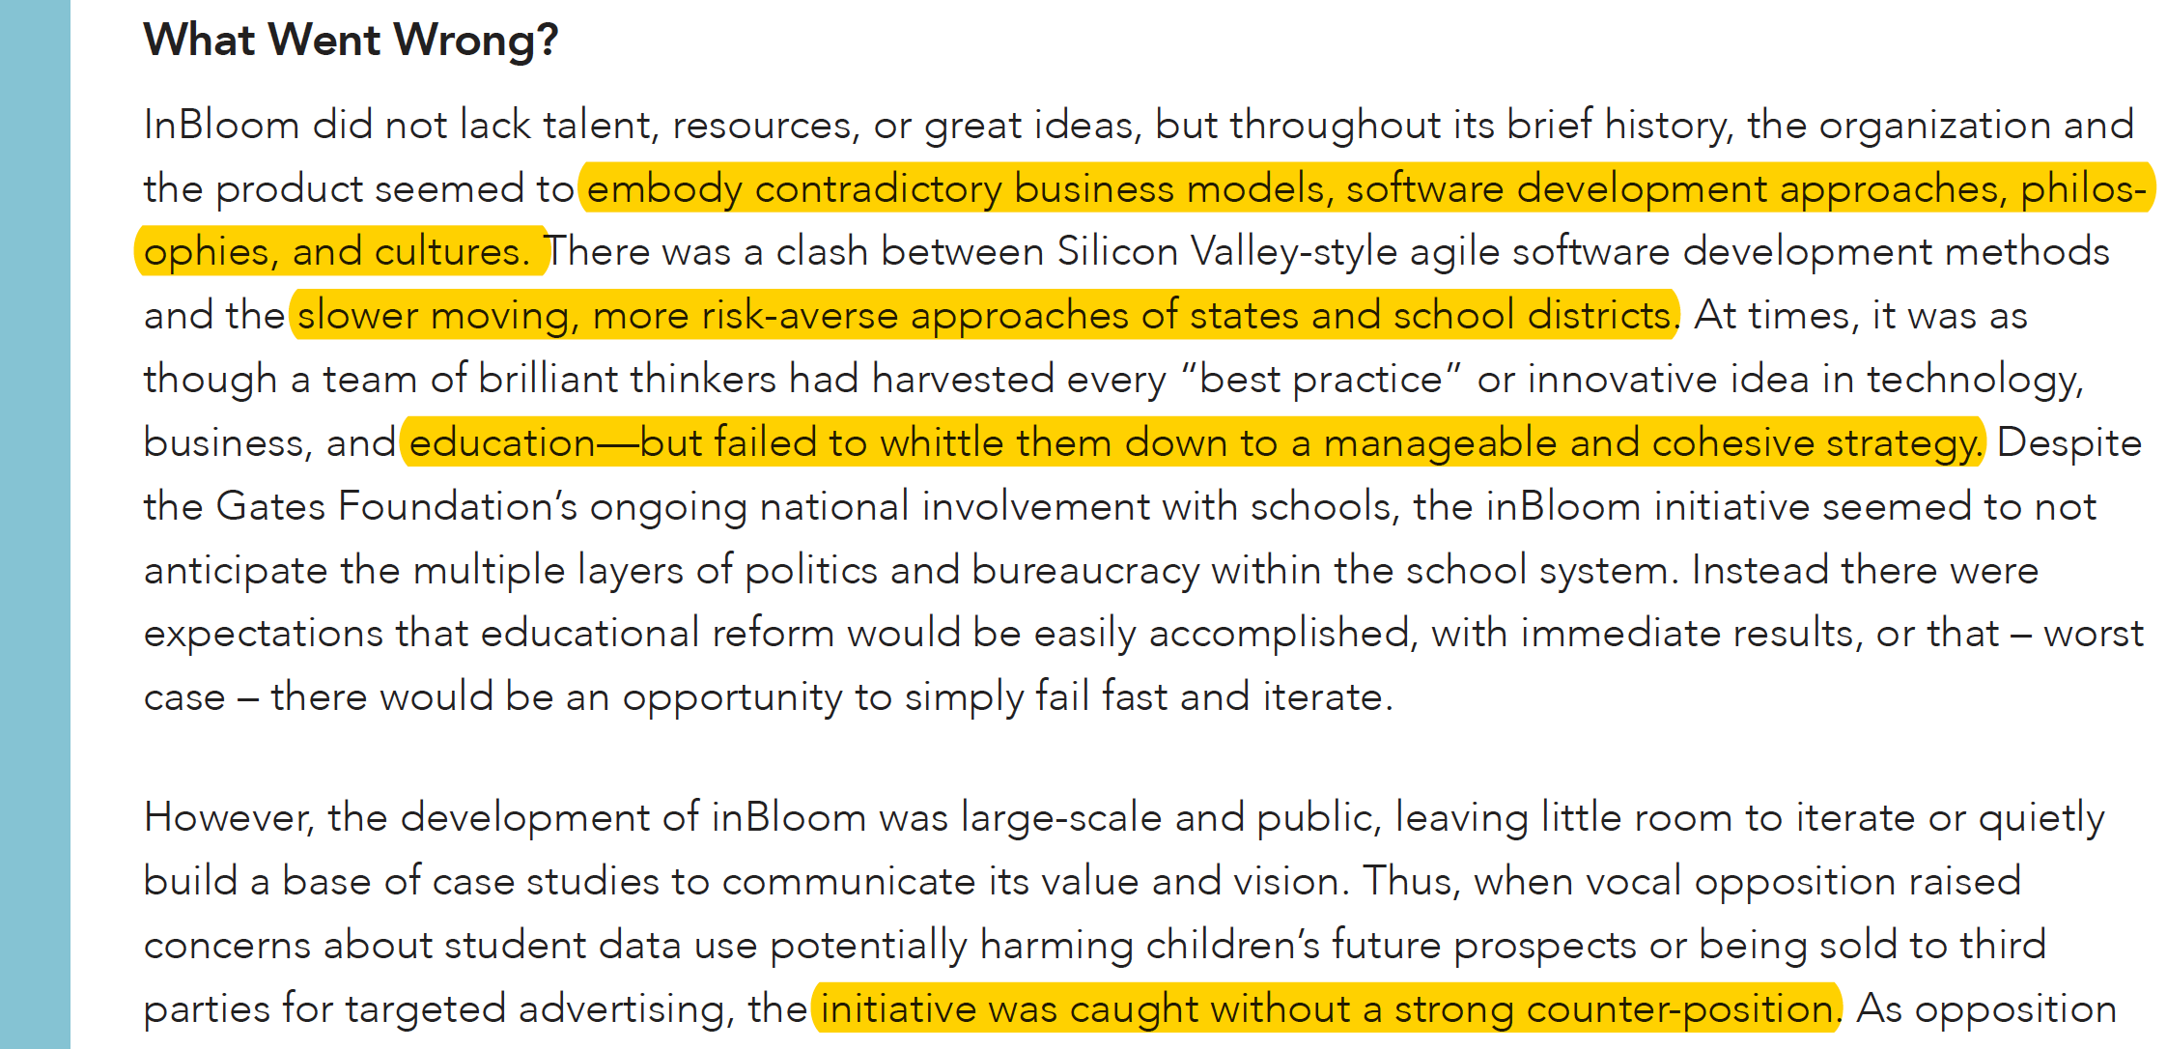

inBloom (2013 – 14)

Slide 26
Foundations for Ethical Decisions/ Stances?
What is the source of your beliefs
in such cases?
Ethical standards
Religious beliefs
Organizational Goals
Past experience

Slide 27
Foundations for Ethical Decisions/ Stances?
Regulations (Govt, private)
Personal beliefs
Culture
Ethical Codes / Frameworks /Standards
Nuremberg Code
Belmont Report

Slide 28
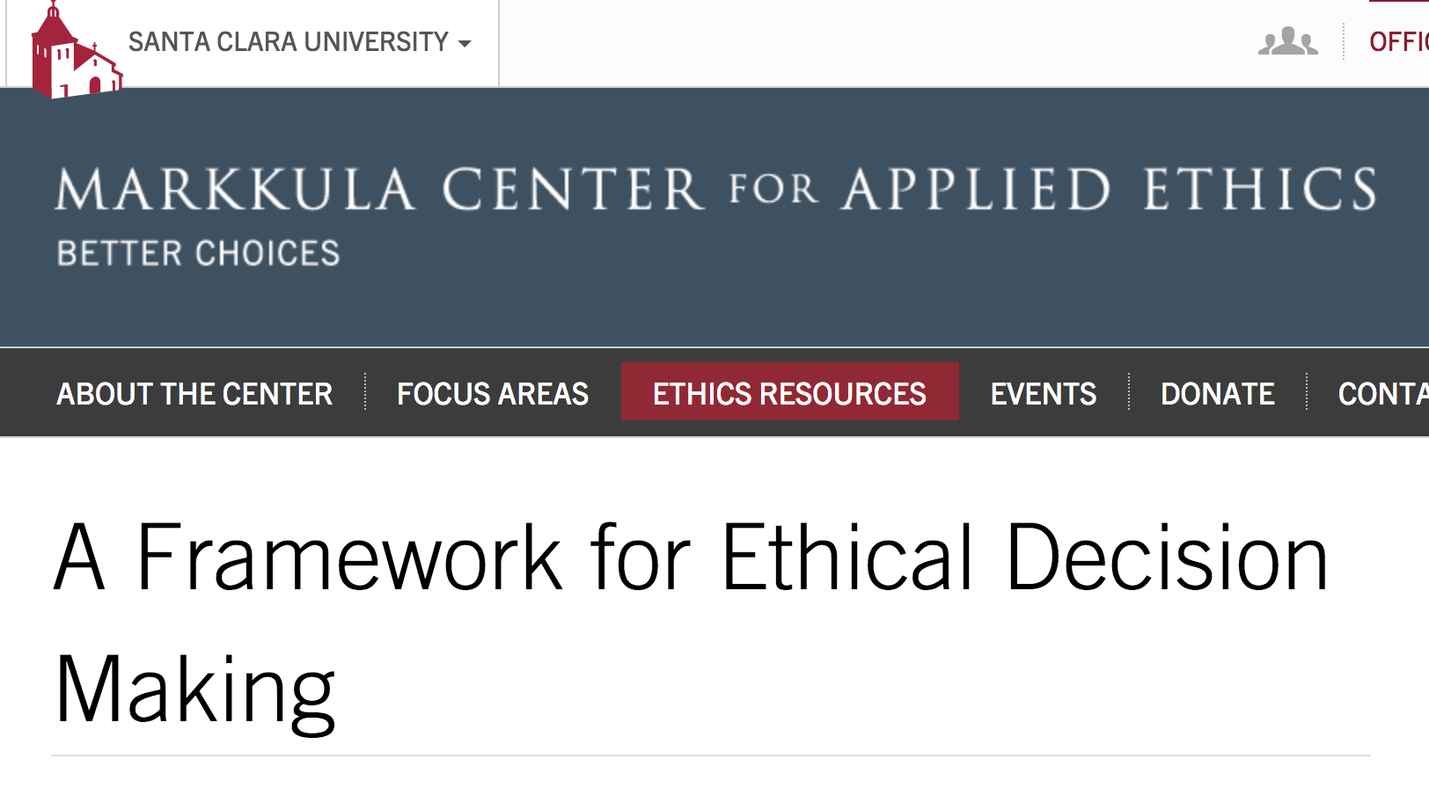
Ethical Codes

Slide 29
Contempary Ethical Codes
respect for persons (autonomy, privacy, informed consent)
balancing of risk to individuals with benefit to society
careful selection of participants
independent review of research proposals
self-regulating communities of professionals
funding dependent on adherence to ethical standards
Metcalf, Jacob. 2018. “Ethics Codes: History, Context, and Challenges.” Council for Big Data, Ethics, and Society. Accessed April 16, 2018. https://bdes.datasociety.net/council-output/ethics-codes-history-context-and-challenges/.

Slide 30
Wrap up …
Evolving field
Ambiguous situations
Policies, regulations and frameworks can help
And…. Much will probably be decided in the judicial system

